Slide 1
Plastic Laminates
What are they & how the are made.
Wood Manufacturing & Finishing Phase 4

Slide 2
Plastic Laminates
What is Plastic Laminate?
Plastic laminate is one of the most frequently used countertop surface materials.
Why is it used?
Plastic laminate is durable, affordable, and available in a wide variety of patterns and colours.
How long is it around?
The Formica Corporation was founded in 1913, plastic laminate was used mainly in the electrical industry as an insulator, in cars and radios, and then later for furniture.

Slide 3
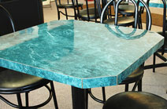
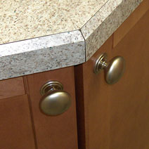
Plastic Laminates on Counters
Most countertops have either square or rolled edges, but the edges may also be bevelled or have materials such as wood, solid surface materials, or metal incorporated into them.

Slide 4
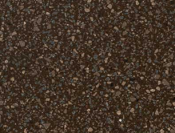
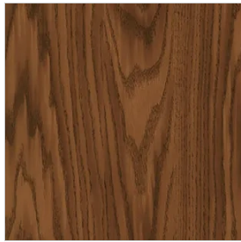
Plastic Laminates on Counters
Plastic laminate countertop choices are almost limitless.
There are 100’s of colour and types.
Patterns are available to mimic wood, stone, metal, or even leather.
The surface finish may be smooth, textured, glossy, or matt.
Chipped Chocolate English Oak
Samples taken from Wilsonart

Slide 5
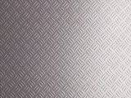
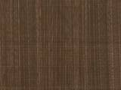
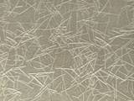
Plastic Laminates with Metal
Formica Deco Metal is a high pressure laminate that incorporates authentic metal (bronze, aluminium, stainless steel, copper or tin) in its surface.
It is especially suitable for vertical applications.
Finishes include textured, satin, matt or brushed.
Tread works Copper Veil Metallic Grass
Samples taken from Formica

Slide 6
Plastic Laminates
Plastic laminate how is it made?
Layers of Kraft paper impregnated with phenol resin, a sheet of printed or colored melamine resin impregnated paper and a clear top sheet of melamine are put in a press and bonded together at 1500psi at temp. exceeding 250˚F.
This induces a chemical change and the result is a sheet with outstanding qualities of likeness, toughness, durability, resistance to heat, moisture, acids etc.
Melamine is an organic base chemical most commonly found in the form of white crystals rich in nitrogen. It is one the hardest of all manmade organic materials

Slide 7
Impregnating the Paper
The process begins by soaking strips of paper in resin. Decorative plastic laminates can be made in different grades or thicknesses, depending on its intended use.
There may be from 7-18 layers of paper combined into the final sheet.
The bottom layers are Kraft paper. The Kraft paper is run through a bath or vat containing phenolic resins.
The next layer is the decorative layer. This is a sheet of paper printed with the colour or design that will show through the clear top layer for the desired surface pattern. This sheet is run through a melamine vat.
The paper for the top layer of the sheet is translucent. This is also run through a vat of melamine resin.

Slide 8
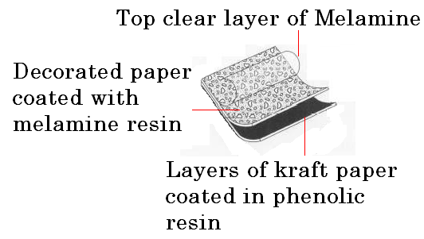
Pressing the layers
The resin-impregnated sheets are then put into a drying chamber. Next, they are cut and stacked in layers. The clear layer and the decorative layer are on top of the kraft paper.

Slide 9
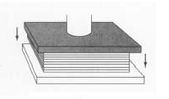
Pressing the layers
The layers of paper are then loaded onto a flat-bed hydraulic press for final curing.
The press compresses the sandwich of resin-soaked paper at 1,500 psi, while heating it to a high temperature exceeding 250˚F.
The heat catalyses a reaction in the resins. The phenol (or melamine) and formaldehyde molecules attach to each other in an alternating-chain fashion, releasing water molecules in the process.

Slide 10
Finished Laminate
The resins flow together and then set. Thermosetting converts the paper sheets into one single, rigid laminated sheet.
This result is a sheet with outstanding qualities of likeness, toughness, durability, resistance to heat, moisture and acids.
What does thermosetting mean?
Thermosetting means that the sheet can only be reshaped at high temperatures.
Laminated plastics are available in sheets up to 3m long by 1.5m wide, they are produced in various thicknesses from fractions of a millimeter to 1mm.
They are made in a wide range of opaque colors and patterns.
They may also incorporate in their surface original drawings, paintings, printed fabrics or wood veneers. Noyeks

Slide 11
Plastic Laminate Properties
Can you name some?
Laminate properties have to be tested to be able to meet these specifications:
Resistance to surface abrasion.
Resistance to boiling water & steam.
Resistance to dry heat.
Dimensional stability.
Resistance to impact, cracking & scratching.
Resistance to discolouration & colour change under artificial lighting.
Resistance to cigarette burns.
Post-formability. What does this mean?

