Slide 1
Wood Manufacturing & Finishing
Introduction
Phase 4
Lecturer Jennifer Byrne

Slide 2
Wood Manufacturing and Finishing
Topics covered in Modules 1,2 & 3.
Perimeters and Areas
Pythagoras’ Theorem
Transformation of Formulae
Cutting lists for various items
Costings & percentage waste
Ratio & Proportion
Bar Charts / Pie Charts
Simple Interest
Depreciation

Slide 3
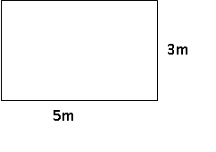
Basic rule of thumb for any maths question
Write Down Formula
Put in what you know
Calculate the answer (There can only be one unknown quantity in any formula)
Example: Calculate the area of the following rectangle.
Formula :
Length x Height = Area
5 x 3 = Area
5 x 3 = 15
Answer = 15m²

Slide 4
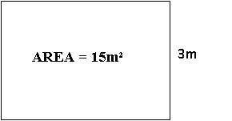
Transformation Of Formulae
Basic rule of thumb for any maths question still applies:
Write Down Formula
Put in what you know
Calculate the answer (There can only be one unknown quantity in any formula)
Example: Calculate the area of the following rectangle.
Formula :
Length x Height = Area
Length x 3 = 15
(we need to get the unknown quantity on it’s own)
Length = 15 ÷ 3
Answer = 5m

Slide 5
In all Math Questions
Always write down the formula.
If you write down a question line by line and work through it there is less chance of making a mistake.
Always work in full units (e.g. change out of mm to metres)
Always state what unit the answer is in (e.g. for area it will be m²)
And most important
If you don’t know or are unsure about anything – ask!

Slide 6
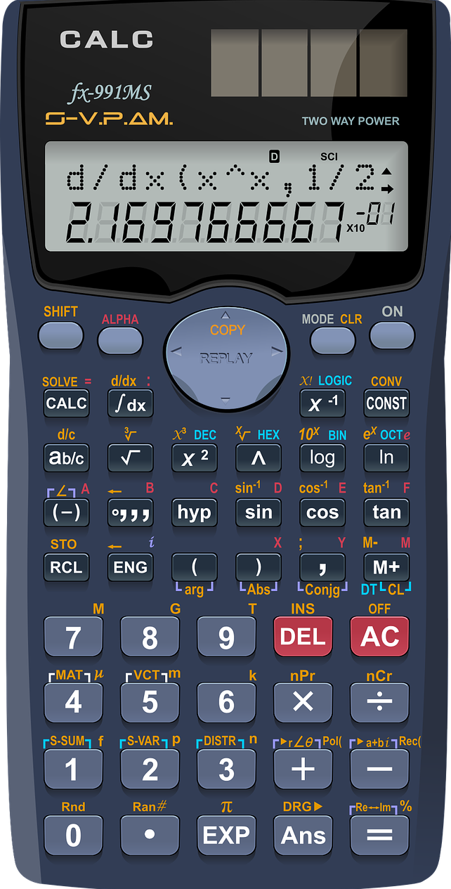
Calculators
Different models of calculators have 2nd function buttons in different places. On this model it is the SHIFT button
Make sure that you become familiar with them by carrying out simple or known calculations.
Be careful pressing the equals button too many times.
Inverse Cos or Cos¯¹ press SHIFT Cos to convert decimal number to degrees.

Slide 7
Wood Manufacturing and Finishing Week 1
Topics covered this week
Perimeters
Areas
Transformation of Formulae
Pythagoras’s Theorem
Method:
PowerPoint Demonstrations
Worksheets
Discussion of answers
Answers for worksheets will also be provided so Learners are expected to practice methods outside of class to prepare for assessment in week 10.

Slide 8
Content On Website Week 1 Page
PowerPoint on Perimeters
PowerPoint on Areas
PowerPoint on Transformation of Formulae
PowerPoint on Pythagoras Theorem
Formulas as they appear in Log Tables
PowerPoint on sample questions and solutions
Area and Perimeters 1
Revision Circles
Answers to all questions included at the end of PDF.
Website http://wmfmaths.yolasite.com/

Slide 9
You walk into a shop and purchase the following:
2 litres of milk @ €1.59
½ a dozen oranges @ 45 cent each
3 bars of chocolate @ 79 cent each on a buy 3 for the price of 2 offer.
How much will this cost?
You hand over a €20 note and ask for a lotto ticket with quick pick for €4.
How much change should you get?
How much of the lotto win will you pass on to me for reminding you to play?
1.59
2.70
1.58
5.87
€10.13

