Slide 1
Post-forming
What is it & how is it done.
Wood Manufacturing & Finishing Phase 4

Slide 2
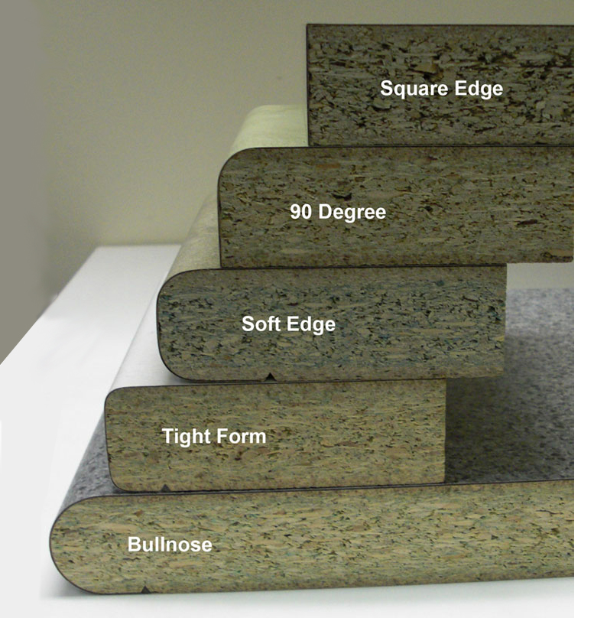
Post-Forming
What is Postforming?
Post forming is bending a flat sheet of laminate over a defined shape using a wiping action, heat and even constant pressure.
The temperature must be monitored so that it does not exceed163°C or surface damage will occur to the laminate such as blistering and discolouration.
Image obtained from Sydney Benchtops

Slide 3
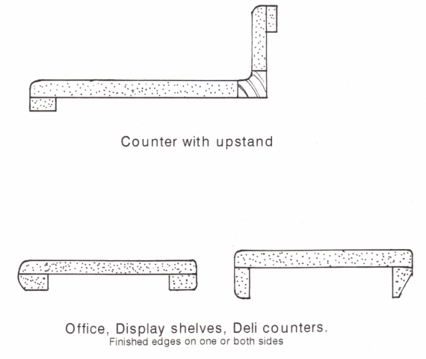
Post-Formed Edges
Can you give me an example of a Post-Formed edge joint?
Why use curved surfaces?
Curved surfaces are less harsh than sharp edges and can reduce the appearance of thicker boards like on Kitchen Worktops.
Where can post-formed Laminate be used?
Post-formed Laminate can be used on internal and external angles gives one continuous surface.

Slide 4


Post-Formed Edges
What is the advantage of one continuous surface?
Post-formed Laminate can provide a continuous shape and at the same time eliminate joints in which dirt and water can gather.
Ideal for counters that will be in wet conditions and are subjected to lots of use, like bathrooms and kitchens of public places, e.g. double rounding and up stands are used on worktops and counters in Deli bars, Public Washrooms etc.

Slide 5
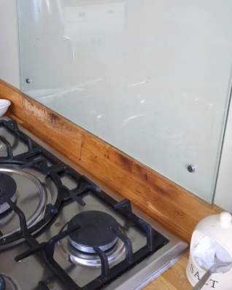
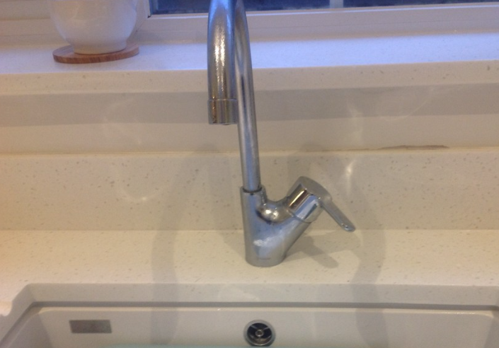
Post-Formed Edges
When should you not use a post-formed upstand?
Behind a hob Behind a Belfast sink

Slide 6
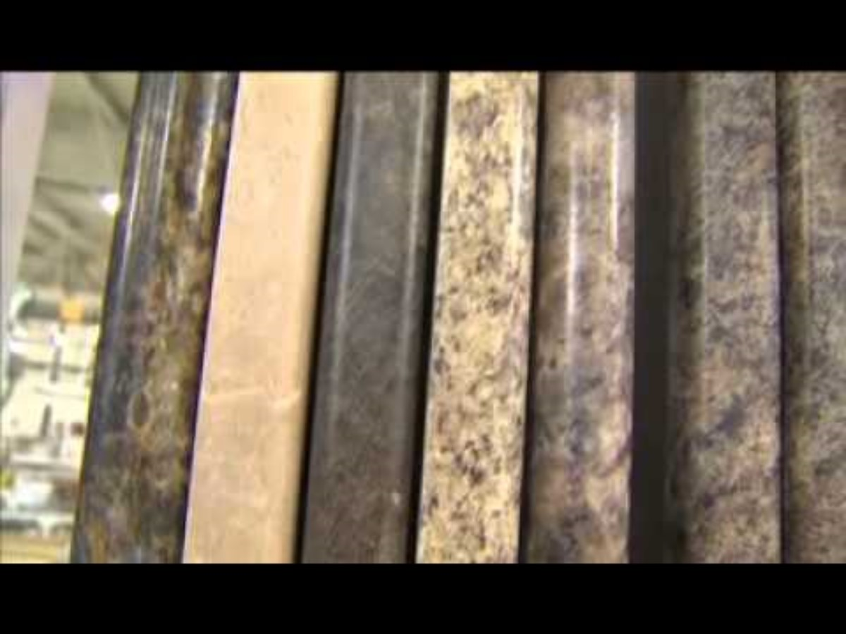
Post –Formed Wortops
https://youtu.be/JzLzuUVKspc?si=VgGO04jOPQEWadRT
Post formed worktops from VT 3.24Mins

Slide 7
Methods of Post -Forming
There are a number of different methods of post forming, e.g. box method, total wrap method and roll former. But the process is always the same
Core preparation: this is crucial to all post forming success. The radius edge or shape must be smooth and continuous and free from dust.
Adhesive applications: Any bumps or hollows will not only interfere with the bond but will show through on the surface of the laminate, esp. on thin or glossy ones.

Slide 8
Methods of Post -Forming
Spray application is the most failsafe method because it gives a smooth even adhesive film. A roller or brush can be used to apply the Neoprene by hand.
Other glues used are phenol-formaldehyde and P.V.A. glues.
Machine methods:
Machines using continuous forming process. They vary considerably in their size and output capacity.
They divide into two groups, using different adhesive systems, i.e. P.V.A.c and contact adhesive.

Slide 9
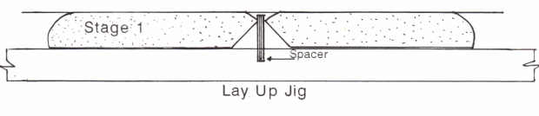
Methods of Post -Forming
Postforming all share a common operating method in that they accept the panel or chipboard worktop which has a rounded edge and the laminate bonded to the flat area of the panel before bending takes place.
Often spacers are in place to ensure that the correct distance is between the grounds when the laminate is being presses onto the flat surface.

Slide 10
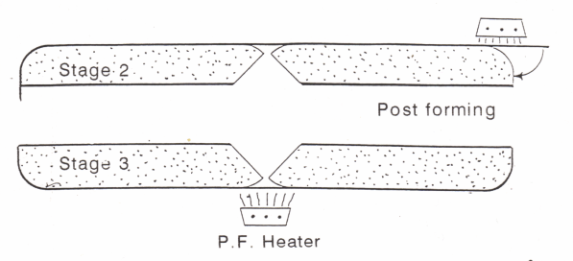
Methods of Post -Forming
The panels are then carried by means of a chain or belt drive through an infra-red heating element, which heats the over hanging portion of the laminate to 163˚ as specified by manufactured.
Stainless steel bars then turn the now softened laminate over the profiled edge, where the contact glue holds the laminate in position.

Slide 11
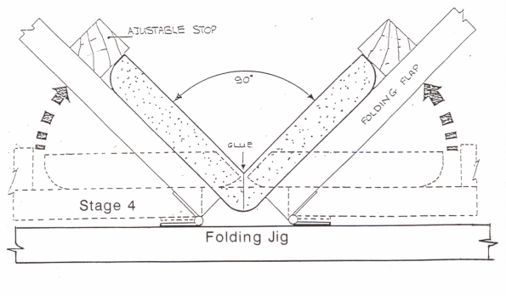
Methods of Post -Forming
Shaped rubber or metal rollers apply pressure to the formed laminate edge until the adhesive is cured and finally the surplus is cut off by another machine.
Laminates can be applied with at the end of a worktop if a metal or wooden end are not used.

Slide 12
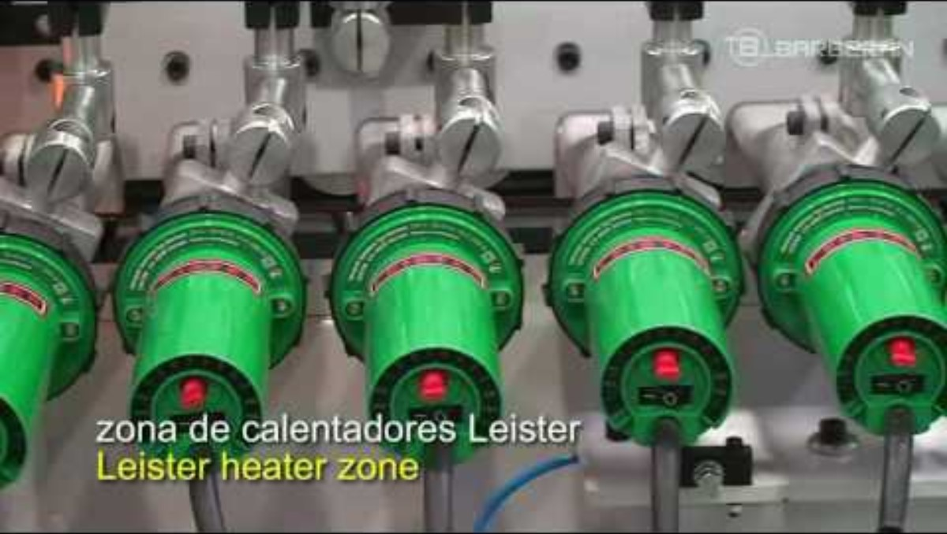
Methods of Post -Forming
https://youtu.be/ZOQBXfRLntE?si=ELmhsIqvNIqVdFWb
Single sided Post forming (1.31Mins)

Slide 13
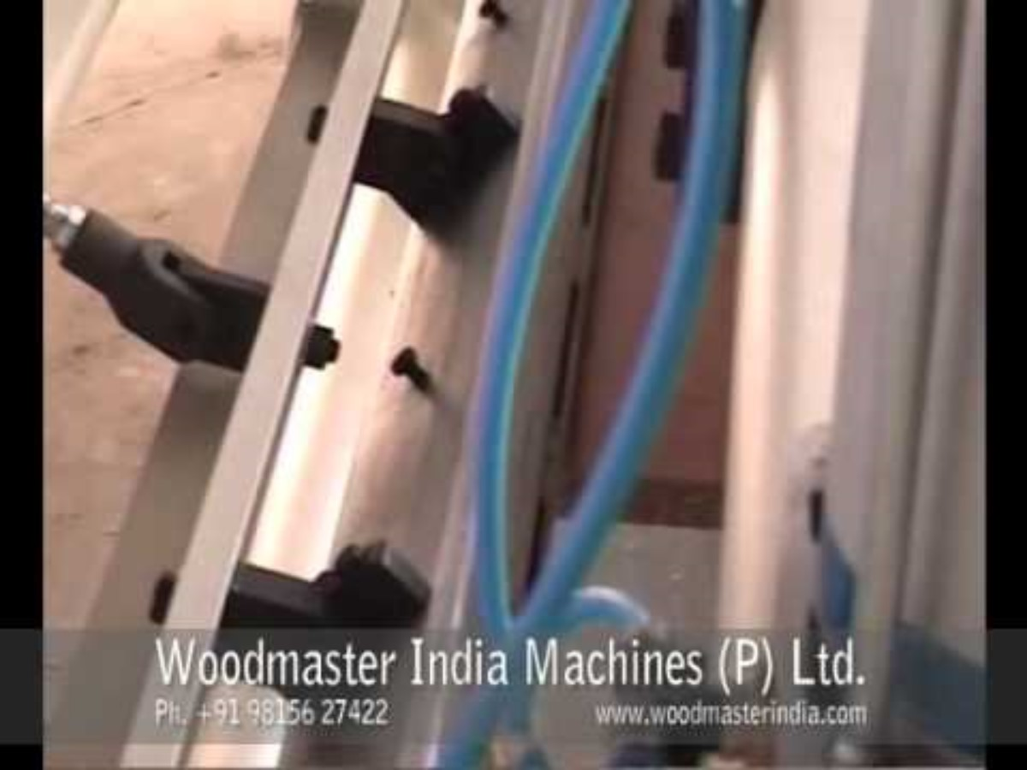
Methods of Post -Forming
https://youtu.be/ALJRBDsmYJs?si=Zh9tqyqVPOW4BK0t
Postforming laminate over edge. (0.54Mins)

Slide 14

Methods of Post -Forming
https://youtu.be/TIby8v_XA9c?si=K0YyPSOeRWvt2gDJ
How Countertops are made Episode 1. (2.54Mins)

Slide 15
Plastic Laminate Properties
Can you name some?
Laminate properties have to be tested to be able to meet these specifications:
Resistance to surface abrasion.
Resistance to boiling water & steam.
Resistance to dry heat.
Dimensional stability.
Resistance to impact, cracking & scratching.
Resistance to discolouration & colour change under artificial lighting.
Resistance to cigarette burns.
Post-formability. Now you know what this means?

Slide 16
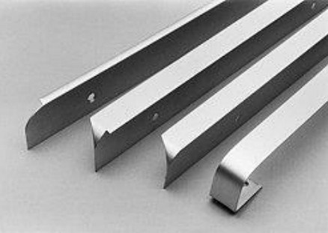
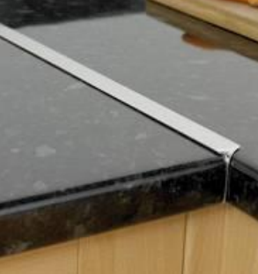
Worktop Jointing
Post-formed worktops can be jointed a number of ways. – Traditional jointing strip.

Slide 17
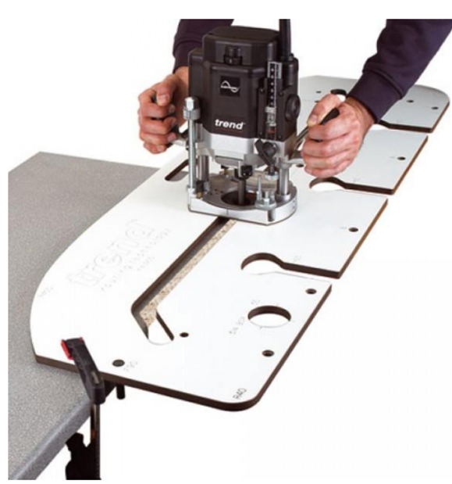
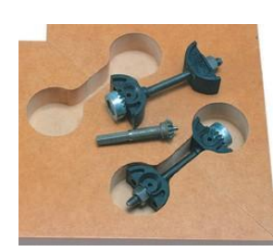
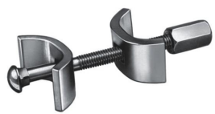
Worktop Jointing
Worktop Router Jig
Worktop Connector Bolts

Slide 18
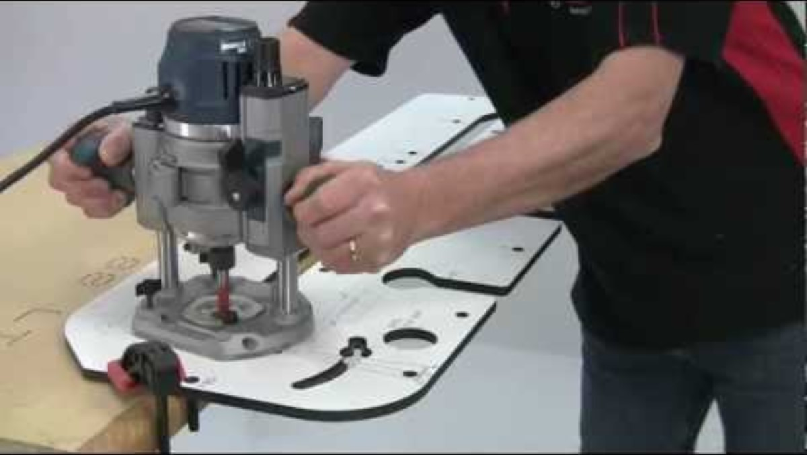
Worktop Jointing
https://youtu.be/Ux3EZhhYdZo?si=D8MwvVpDc9Lq1gJF
Cut a worktop joint (3.27Mins)

Slide 19

Revision Questions
Test yourself
Click the link or scan the OR code below.
Once you have finished the test click submit and compare your answers to the model answers.

