Slide 1
Wood Manufacturing & Finishing
Trend Graphs
Phase 4
Lecturer Jennifer Byrne

Slide 2
Trend Graphs
Q. 1. The following trend graph shows the monthly rainfall in cms in Dublin over 12 consecutive months.
Use the graph to answer the following questions:
Which month had the highest rainfall?
In which two months did exactly 6cm of rain fall?
How many months had 8cm or more of rainfall?
What was the total rainfall for the year?
How many months showed an increase in rainfall?
February
April & November
February, March, October & November
76cm
5 months Jan-Feb, Apr-Mar, Aug-Sep,
Sep-Oct & Nov-Dec.

Slide 3
Trend Graphs
Q 2. The following trend graph gives the number of people employed in a certain construction company for 9 consecutive years from 2010 to 2019.
Use the graph to answer the following questions:
In which year was employment at its lowest?
For how many years were the numbers of employed people at 350 or higher?
Between which two years was there the greatest drop in numbers employed?
Express the number employed in 2017 as a percentage of the employed in 2013.
How many years show a rise in the employed from the previous year?
2018
4 years from 2013 to 2016
From 2016 to 2017
150/400 = 37.5%
3 years from 2012 to 2014

Slide 4
Trend Graphs
Q. 3. The trend graph below shows the sales of two brands of drills Makita and Festool for six months in a Tool Shop.
Use the graph to answer the following questions:
How many Makita drills were sold in March?
Find the total number of Festool drills sold in the six months.
In which months were the sales of Makita drills higher than those of the Festool drills?
Which month had the lowest combined sales of both drills?
If the profit on a Makita drill was €45 and the profit of a Festool drill was €50 calculate the profit made in May from the sale of these drills.
28 drills
100 drills
Jan, Feb & Mar.
Feb 28 drills
€1920 24 x €50 = €1200
16 x €45 = € 720
Total Profit €1920

Slide 5
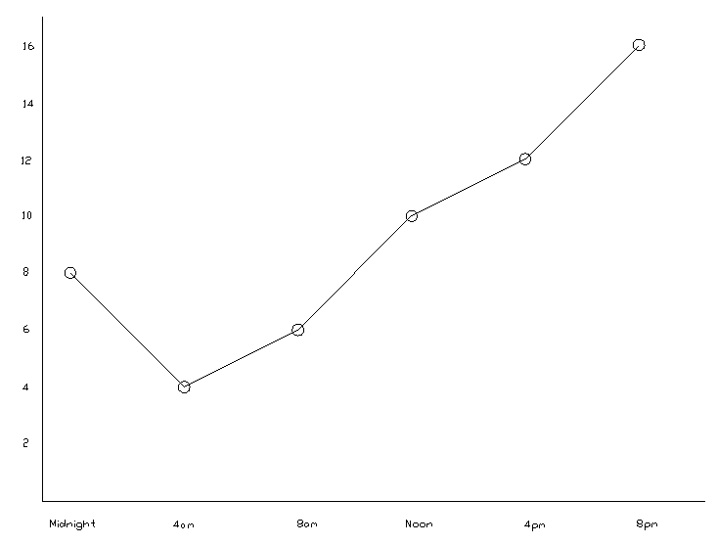
Trend Graphs
Q 4. The temperature in a sitting room was recorded every four hours during a 24hr period. The results are shown in the table below.
Draw a trend graph to represent this information.
Time | Midnight | 4am | 8am | Noon | 4pm | 8pm
Temp in °C | 8° | 4° | 6° | 10° | 12° | 16°

Slide 6
Trend Graphs
Time | Midnight | 4am | 8am | Noon | 4pm | 8pm
Temp in °C | 8° | 4° | 6° | 10° | 12° | 16°

