Slide 1
Wood Manufacturing & Finishing
Perimeters
Phase 4
Lecturer Jennifer Byrne

Slide 2
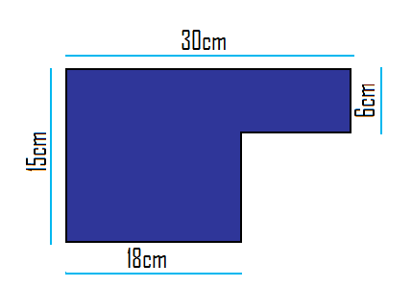
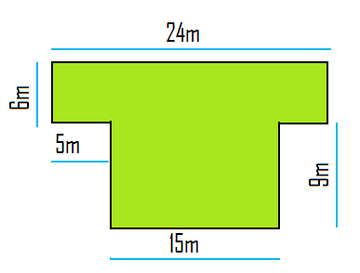
Q 1 Find the perimeter of the shape below
Q 2 Find the amount of skirting needed for the Floor below

Slide 3
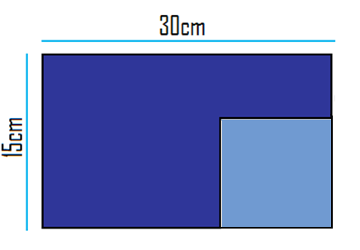
Ans 1
15 + 30 + 6 + 12 + 9 + 18 = 90 cm
0r
Ans 1 If you pull the corners back out you get a rectangle shape which does not affect the perimeter.
2 ( 15 + 30 ) = 90cm

Slide 4
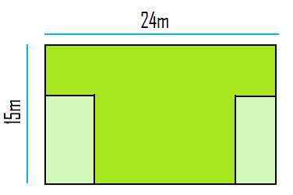
Ans 2
24 + 6 + 4 + 9 + + 15 + 9 + 5 + 6 = 78cm
or
If you pull the corners back out you get a rectangle shape which does not affect the perimeter
Ans 2 2 ( 24 + 15) = 78m

Slide 5
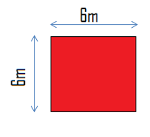
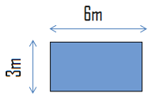
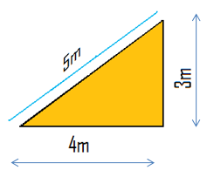
Perimeters
Square: Sum of 4 sides
4 x Length = Perimeter 4 x 6 = 24m
Rectangle: Sum of 4 sides
2 x Length + Width = Perimeter. 2( 6 + 3 ) = 18m
Triangle: Sum of 3 sides 3 + 4 + 5 = 12m
Circle: Length of Circumference 2Πr = perimeter
2 x 3.14 x 3 = 18.84m
Ø = diameter r = radius

Slide 6
Perimeter Sheet 1
Find the perimeter of the following Squares:
Q1 Side 32m
Q2 Side 14m
Q3 Side 21m
Find the perimeter of the following Rectangles:
Q1 Length 4.71m width 2.1
Q2 Length 6.23m width 3m
Q3 Length 4.25m width 1.05
Find the Circumference of the following Circles:
Q1 Diameter = 25m
Q2 Radius = 6m
Q3 Diameter = 42m

Slide 7
Perimeter Sheet 1 Answers
Find the perimeter of the following Squares:
1 32 x 4 = 128m
2 14 x 4 = 56m
3 21 x 4 = 84m
Find the perimeter of the following Rectangles:
1 2(4.71 + 2.1) = 13.62m
2 2(6.23 + 3) = 18.46m
3 2(4.25 + 1.05) = 10.60m
Find the Circumference of the following Circles:
1 2 x 3.14 x 12.5 = 78.5m
2 2 x 3.14 X 6 = 37.68m
3 2 x 3.14 x 21 = 131.88m

