Slide 1
Alternative Worktops
An overview of worktops made from a variety of material
Wood Manufacturing & Finishing Phase 4

Slide 2
Alternative Worktops
Granite
Marble
Engineered Stone
Solid Wood
Composite Resin Corian©, LG©
Stainless Steel
Glass
Epoxy Resin

Slide 3
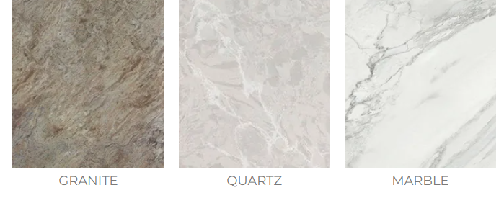
Granite Worktops
Granite is one of the most durable work surfaces for use in the kitchen.
The uses of Granite is not just limited to work surface, Granite can be used for splash backs and windowsills.
Granite worktop can also be enhanced with a recessed drainer, curved flutes and under mounted sink cut outs.
Click the link to see McKenna Stone range of products.

Slide 4
Granite Worktops
While granite is very hard and scratch resistant, it can stain. When spills occur, wipe them up immediately.
Red wine stains will clearly show up more on light granite.
Clean greasy, oil-based spills with hydrogen peroxide or an ammonia-based cleaner and paint thinner.
To learn about “18 Awesome Countertops That Aren’t Granite” click this link.

Slide 5
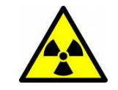
Radioactive Granites
It is possible for any granite sample to contain varying concentrations of uranium and other naturally occurring radioactive elements.
However, at this time the Environment Protection Agency believes that the existing data is insufficient to conclude that the types of granite commonly used in countertops are significantly increasing indoor radon levels.
While radiation levels are not typically high, measurements of specific samples may reveal higher than expected levels on a case-by-case basis.

Slide 6
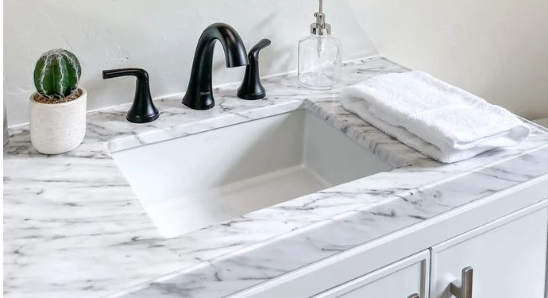
Marble
Expensive; porous; stains easily unless professionally sealed; can scratch; may need resealing periodically. Soda drinks and fruit juices etch the surface.
Not recommended for Kitchen Worktops.
Marble Sink Top. Image courtesy of
Thomas De Wever/Getty Images

Slide 7
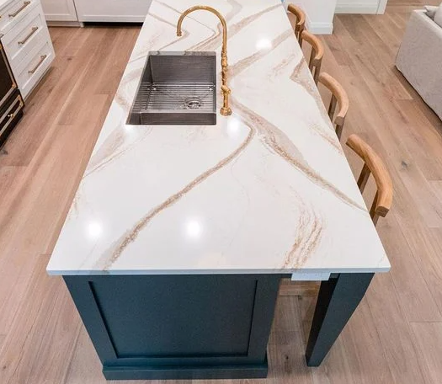
Engineered Stone
Engineered stone is composed of 93% quartz particles. It is available in a larger range of colours,and has a nonporous surface that resists scratches. It is easy to maintain, without annual sealing required.
Benefits : Is resistant to stain and acid, and easy to look after.
Quartz worktop Image courtesy of
Enns Cabinetry
Drawbacks : Expensive and can be difficult to source in Ireland.
Engineered Quartz can provide the look of Marble without the maintence.

Slide 8
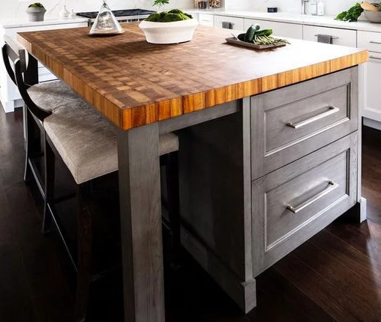
Wood or Butcher Block
Wooden worktops offer a beautiful warm look and are available in a wide range of colours and finishes. Hardwoods such as maple and oak are common in Irish kitchens, particularly farmhouses.
Benefits :Easy to clean; smooth; can be sanded and resealed as needed.
Drawbacks: They can be damaged by water and stains over time. Scratches must be oiled, or sealed.
Butcher Block table Image Courtesy of
Ellece Designs

Slide 9
Corian
Corian is the original solid surface material manufactured by DuPoint.
Composed of acrylic resin and a mineral filler, Corian® is supplied in sheets and shapes, and offers a wide range of performance and design benefits.
Solid and non-porous, Corian® is stain- and chip-resistant. As colours and patterns run through the entire thickness of the material, if a scratch occurs, it can easily be sanded away and the surface restored to its original appearance.
Click the link to watch Bending Solid Surface. 1.36Mins

Slide 10
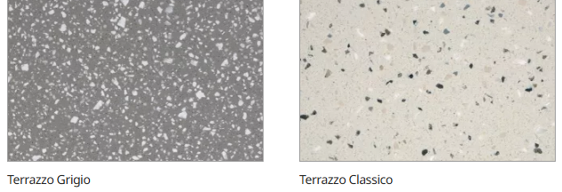
Corian
Corian can be routed, carved, sandblasted, moulded, thermoformed (bent when heat-treated), inlaid, or even printed to fulfil virtually any design vision.
Available in around 100 colours, Corian complements many other materials, such as wood, metal and stone, enabling it to fit in with a range of design styles.
Click the link to see LX Hausys range of products.

Slide 11
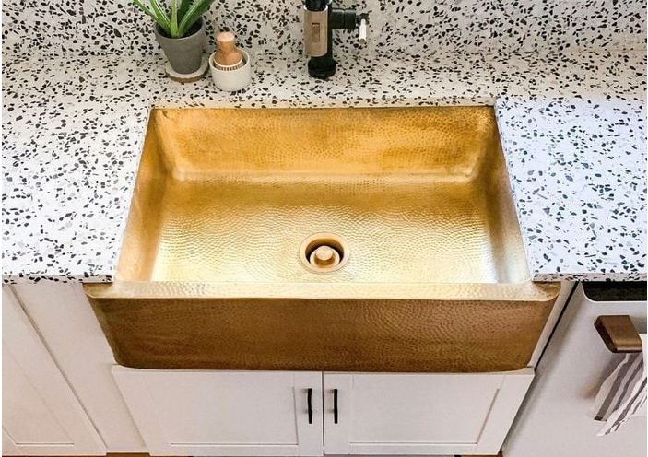
Terrazzo
Terrazzo is similar to recycled glass it is made by pouring a solid layer of concrete or epoxy resin, then embedding chips of marble, stone, glass or other materials into the surface.
Terrazzo worktop Image courtesy of
Cassie Bustamante

Slide 12
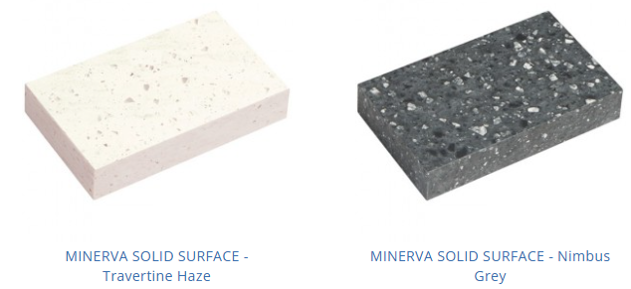
Iolite Man Made Stone
Iolite is manufactured from a combination of acrylic resin, natural mineral fillers and pigments resulting in its unique STONE-LIKE texture and feel.
Iolite’s 13mm thick surface and 45 mm edge allows you to fabricate a surface designs and edge details to your specific needs.
Click the link to see Noyeks range of products. Minerva

Slide 13
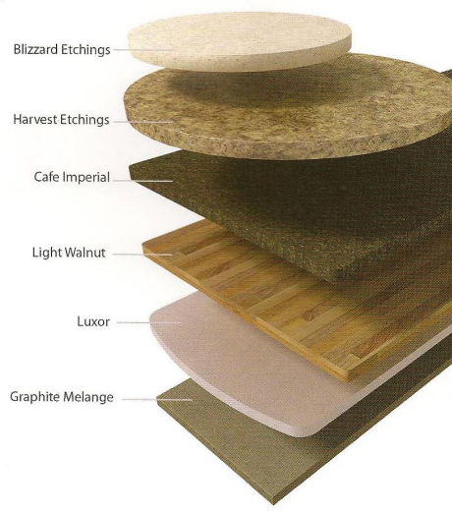
Curved Plastic Laminate
There are a number of companies producing curved laminate tops to order.
A PVC edging is bonded onto a square edge and a small radius is then applied.
Leading edge worktops.
Click the link to see Formica range of products.

Slide 14
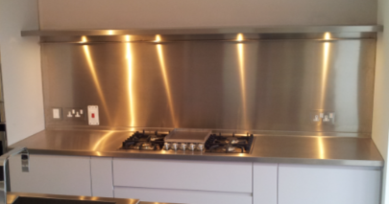
Stainless Steel
For a really contemporary and cool look for your kitchen, stainless steel is a good choice. The tops are heat resistant and durable and they benefit from the fact that you can have a seamless countertop.
Benefits; They take hot pans; easy to clean.
Drawbacks; Expensive; noisy; may dent; fabrication is expensive.
Click the link to see De Delvo range of products.

Slide 15
Glass Worktops
The use of glass as a worktop in Irish kitchens is quite new. Modern technology has ensured that glass in such a function works well. Glass worktops have heat resistant panels immersed at production point to ensure cracks or defacing heat stains do not occur.
It is available in a wide range of pale rather than definite colours and is more suited to a modern kitchen style such as stainless steel. Quite expensive and needs regular attention to keep the glossy appearance from fading or being the victim of stained swirl marks.
Click the link to see Presti Glass range of products.

Slide 16
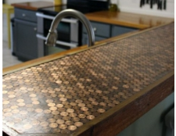
Epoxy Resin Counter Tops
Epoxy resin can be used to encase anything.
Always be aware of your health and safety when using Epoxy and other types of resins especially when sanding. HSE Information Sheet on Epoxy Resin.
Coins in Epoxy resin
Image Courtesy of Digddigs.com
Liquid Glass available here
Deep Pour Liquid Glass available here
Various Epoxy Resins available here
Click the link to see 45 Unique Kitchen Countertops of Different Materials

