Slide 1
Wood Manufacturing & Finishing
Areas
Phase 4
Lecturer Jennifer Byrne

Slide 2
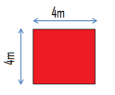
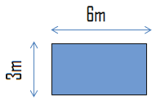
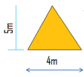
Areas
Square Length x Width = Area
4 x 4 = 16m²
Rectangle Length x Width = Area
6 x 3 = 18m²
Triangle ½ Base x Perp. Height = Area
½ (4m x 5m) = 10m²
Circle Πr² = Area
3.14 x 3 x 3 = 28.27 m²
Ø = diameter r = radius

Slide 3
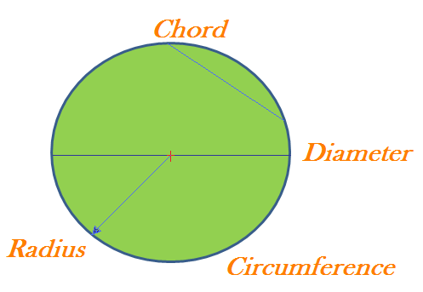
Parts of a Circle
A circle is a plane figure that has one continuous line called its Circumference.
A straight line that touches the circumference in two places is called a Chord.
The longest chord in a circle is the Diameter.
The Diameter crosses the circles centre point.
The Radius is the distance from the centre point to the circumference.
Formula for Perimeter of Circle is 2Πr.
Formula for Area of circle is Πr²

Slide 4
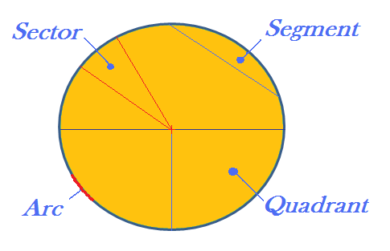
Parts of a Circle
The area between a chord and the circumference is called a Segment.
The area between two radii is called a Sector.
A section of the circumference is called an Arc.
A quarter of a circle is called a Quadrant.
Half of a circle is called a Semicircle.
Formula for these shapes are in the log book.

Slide 5
Area Sheet 1
Find the area of the following Squares:
1 Side 32m
2 Side 14m
3 Side 21m
Find the area of the following Rectangles:
1 Length 4.71m width 2.1
2 Length 6.23m width 3m
3 Length 4.25m width 1.05
Find the area of the following Triangles:
1 Base 6 Perp. Height 4.12
2 Base 3 Perp. Height 5.05
3 Base 4 Perp. Height 3.31
Find the area of the following Circles:
1 Diameter = 12m
2 Radius = 8.21m
3 Diameter = 42m

Slide 6
Area Sheet 1 Answers
Find the area of the following Squares:
1 32 x 32 = 1024m²
2 14 x 14 = 196m²
3 21 x 21 = 441 m²
Find the area of the following Rectangles:
1 4.71m x 2.1 = 9.891m²
2 6.23m x 3m = 18.69m²
3 4.25m x 1.05 = 4.463 m²
Find the area of the following Triangles:
1 ½(6 x 4.12) = 12.36m²
2 ½ (3 x 5.05) = 7.57m²
3 ½ (4 x 3.31) = 6.62m²
Find the area of the following Circles:
1 3.14 x 6 x 6 = 113.04m²
2 3.14 x 8.21 x 8.21 = 211.64m²
3 3.14 x 21 x 21 = 1384.74m²

