Slide 1
Wood Manufacturing & Finishing
Pythagoras’s Theorem
Phase 4
Lecturer Jennifer Byrne

Slide 2
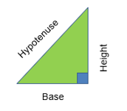
Pythagoras’s Theorem
Pythagoras’ Theorem: The Square on the Hypotenuse is equal to the sum of the squares on the other two sides.
Only works with a right-angled triangle that is a triangle with an angle of 90°.
In any right-angled triangle, if we have two sides we can calculate the other side using Pythagoras’ theorem.

Slide 3
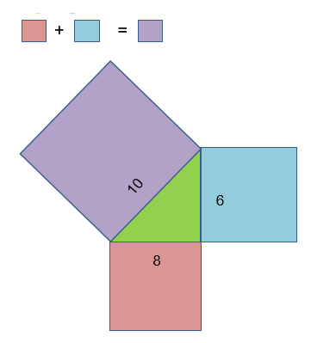
Pythagoras’s Theorem
Formula: a² + b² = c²
8² + 6² = 10²
64 + 36 = 100
√100 = 10

Slide 4
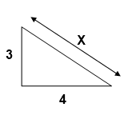
Pythagoras’s Theorem
Example 1
Formula: a² + b² = c²
3² + 4² = x²
9 + 16 = x²
25 = x²
√25 = x
5 = x

Slide 5
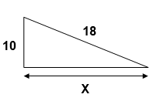
Pythagoras’s Theorem
Example 2
Formula: a² + b² = c²
10² + x² = 18²
100 + x² = 324
x² = 324 – 100
x² = 224
x = √224
x = 14.96662
x = 14.967

Slide 6
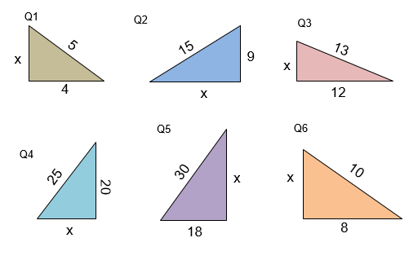
Pythagoras’s Theorem
Find the missing length of each triangle

Slide 7
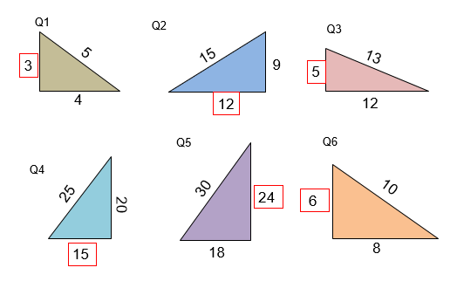
Pythagoras’s Theorem
The missing length of each triangle shown in red box.

Slide 8
Pythagoras’s Theorem
Solution Q1
Solution Q2
5² = X² + 4²
5² – 4² = X²
25 – 16 = X²
9 = X²
√ 9 = 3
15² = X² + 9²
15² – 9² = X²
225 – 81 = X²
144 = X²
√144 = 12

Slide 9
Pythagoras’s Theorem
Solution Q3
Solution Q4
13² = ² + 12²
13² – 12² = X²
169 – 144 = X²
25 = X²
√25 = 5
25² = X² + 20²
25² – 20² = X²
625 – 400 = X²
225 = X²
√225 = 15

Slide 10
Pythagoras’s Theorem
Solution Q5
Solution Q6
30² = X² + 18²
30² – 18² = X²
900 – 324 = X²
576 = X²
√576 = 24
10² = X² + 8²
10² – 8² = X²
100 – 64 = X²
36 = X²
√36 = 6

Slide 11
Area of Triangles
Find the area of each triangle.

Slide 12
Area of Triangles
The area of each triangle.
6m²
54m²
30m²
150m²
216m²
24m²

Slide 13
Area of Triangle
½ base x perp. Height = area
Solutions
Q 1 ½ (4) x 3 = or (4/2) x 3 = 2 x 3 = 6m²
Q 2 ½ (9) x 12 = or (9/2) x 12 = 4.5 x 12 = 54m²
Q 3 ½ (5) x 12 = or (5/2) x 12 = 2.5 x 12 = 30m²
Q 4 ½ (20) x 15 = or (20/2) x 15 = 10 x 15 = 150m²
Q 5 ½ (18) x 30 = or (18/2) x 30 = 9 x 30 = 270m²
Q 6 ½ (6) x 8 = or (6/2) x 10 = 3 x 8 = 24m²

