Slide 1
Surface Finishes
Wood Manufacturing & Finishing
Phase 4

Slide 2
Learning Outcomes
The learning outcomes for this part of module 3 are set out below:
Identify and describe the methods of preparation and finish for stains, varnishes, polishes & paints.
Areas covered are:
Types of stains, varnishes and polishes and their methods of application.
Effects of stains, varnishes, polishes and clear finishes on hardwoods and softwoods.
Importance of removing surplus adhesive from surfaces to be treated.

Slide 3
Timber Preparation
A good surface preparation is essential to achieving a good finish.
Why?
Dents, scratches and blemishes in the surface will be enhanced, not hidden, so very careful preparation is needed.
Glue marks will be covered over true or false?
Surplus glue can also show up badly especially on stained work as orange or green staining depending on the glue and the type of wood. – Can you give any examples of this?
What can cause black or blue staining on wood especially Oaks and Mahogany ?
Reaction of the tannin acid in the timber to the water and metal.

Slide 4
Methods of Application
Name 4 methods of applying a finish.
Ragging: applying a finish with a rag but it must be a lint free cloth, not suitable for lacquers or varnishes. Mainly suitable for stains and oils.
Brushing: finish penetrates deeper into timber, lots of different brushes to suit different finishes. Pure bristle to synethic bristle. Longer bristle for varnishes. The high quality the bristle the less brush strokes will show.
Paint Pads: various materials use mohair is best but expensive, synethic fibre cheaper, short pile. Newer version is the sponge pads on sticks.
Roller mainly used for paint different sleeves available to suit different finishes.
Spraying: faster than all of above, suction cup or gravity fed, airless system or High Volume Low Pressure (HVLP).

Slide 5
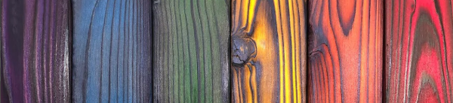
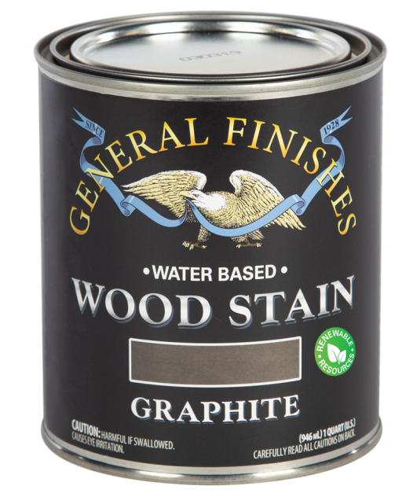
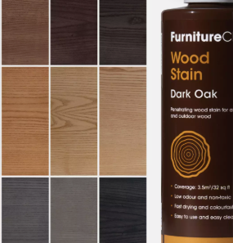
Wood Stains & Finishes
Stains are available in:
Water based stains.
Chemical stains.
Spirit based stains.
Oil based stains.
Solvent based stains.
Click on the images to bring you to website selling them.

Slide 6
Water Based
Water tends to raise the grain, so it is best to pre-treat area by damping the surface and sanding when dry before applying a water-based stain or finish.
Dry pigments that are mixed with water.
Wide range of shades.
Easy to use and resistant to fading.
Very cheap to buy.

Slide 7
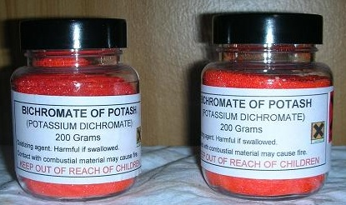
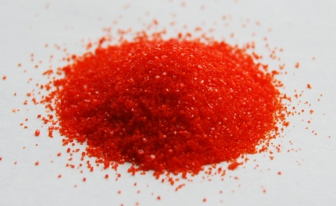
Chemical Stains
Chemicals that react to the tannic acid in timber to change the colour of the wood.
Bichromate of potash: use this chemical with caution as it is poisonous.
This will turn Mahagony a darker brown but leave the Boxwood Inlay yellow.
Click link to bring you to webpage where more data can be obtained.

Slide 8
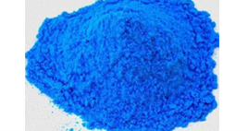
Chemical Stains
Copper sulphate: is also known as Blue Vitriol. Dissolve 2 ounces in a pint of water and use this as a stock solution. Caution Very Poisonous.
Ammonia: the fumes react chemically with tannins in the wood causing it to permanently change colour. The technique was popularized by Gustav Stickley and other Arts and Crafts furniture makers of his era.
You cannot foresee what effect these chemical stains will have on the timber, so it is best to try them out on a sample first.
For more information on chemicals visit Wood Finishing Enterprises.

Slide 9
Spirit Based
Dry pigment powder dissolved in methylated spirit and then add French polish.
The polish acts as a binder otherwise the meths. will evaporate leaving behind the pigment.
Difficult to use on large surfaces.
Also tends to fade.
For range of colours click on the link below.
Restoration Materials

Slide 10
Oil Based
How do you think oil-based stains/varnishes compare to water based?
They are slower to dry than water based.
Do not penetrate as much as the rest.
Less chance of overlap marks.
Need plenty of drying time.
Oil polish does not crack or blister or show heat or water marks ideal for garden furniture, tabletops, bar counters etc.
Some are non-toxic. Can you give me an example of where non-toxic oils might be used?

Slide 11
Oil Based
Danish Oil
Excellent on pine, it is made from Tung Oil or Linseed oil, used for extra protection and durability. It gives a natural low lustre finish.
Lemon Oil
This provides a suitable finish for teak and matt finished woods where a wax finish is not desired. It has the aroma of fresh lemons.
Linseed Oil
A natural product available in natural (non-toxic) and boiled form.
Moderate heat and water resistance.
Olive Oil
Used on salad bowls & utensils non-toxic.

Slide 12
Oil Based (Cont.)
Teak Oil
Based on Tung Oil and added resins, it gives a quick drying penetrating seal to teak and similar woods. It leaves a slight sheen when dry.
Tung Oil
This oil made from the pressed seed from the Tung nut tree gives a superior finish to that of linseed oil, and is water-resistant. It can be easily applied using rag.
Rubio Monocoat
Only 1 layer
Natural ingredients
0% VOC
No overlaps
40 colours

Slide 13
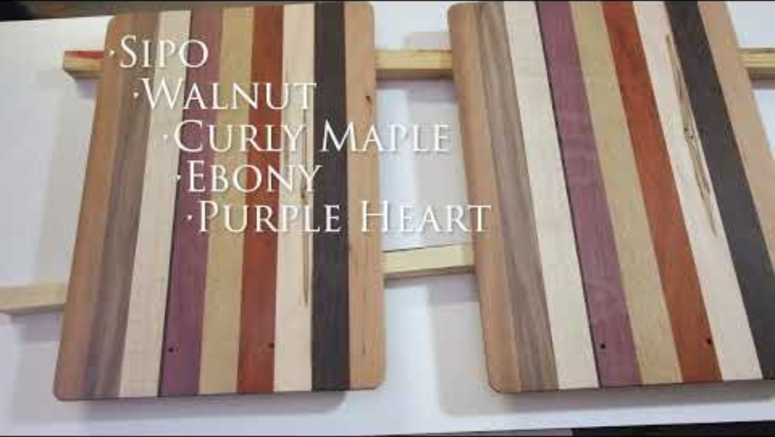
Boiled Linseed Oil Vs 100% Pure Tung Oil After 5 Years
  7.26Mins https://youtu.be/aklfthQN-q8?si=wyltsSfVitX23EoJ

Slide 14
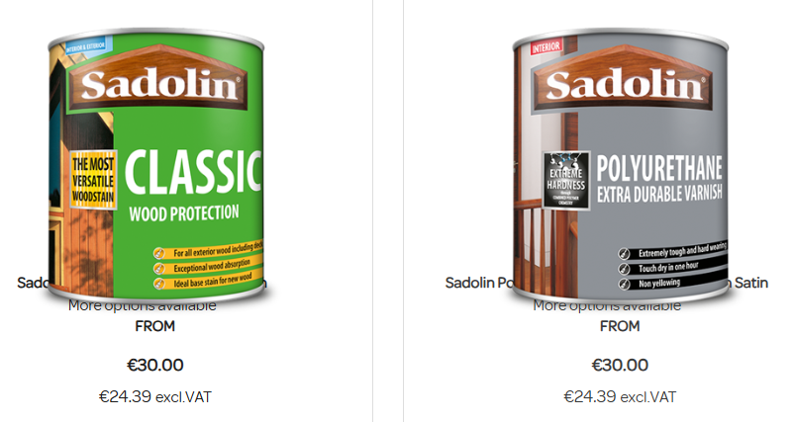
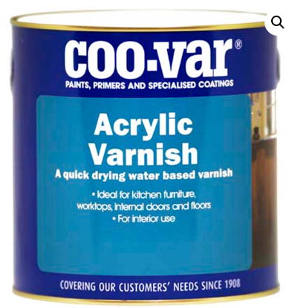
Solvent based (varnish & stain)
A polyurethane varnish combined with a wood stain, so the stain tends to sit on the surface of the timber rather than being absorbed into it.
Each coat applied will darken the wood further. Video link Classic 1Min
Acrylic Varnish
Quick drying and non-toxic, brushes can be rinsed out in water. Available in gloss, satin and matt finishes.
Crown Decorating Centres
Carbon Paint Centre

Slide 15
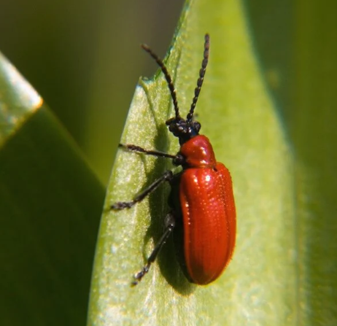
French Polish
French polishing is a technique used to seal and protect the surface of the wood while enhancing the natural beauty of the wood.
Material used is shellac and methylated spirit.
What is shellac?
Shellac comes from the secretion from female Lac Beetles.
The art of French Polishing takes a long time to master.
Can produce a good finish on furniture.
A high gloss can be achieved by applying numerous thin coats
In addition to standard French Polish, other finishes are available.
Typically, the finish that would have been used on antique Furniture.

Slide 16
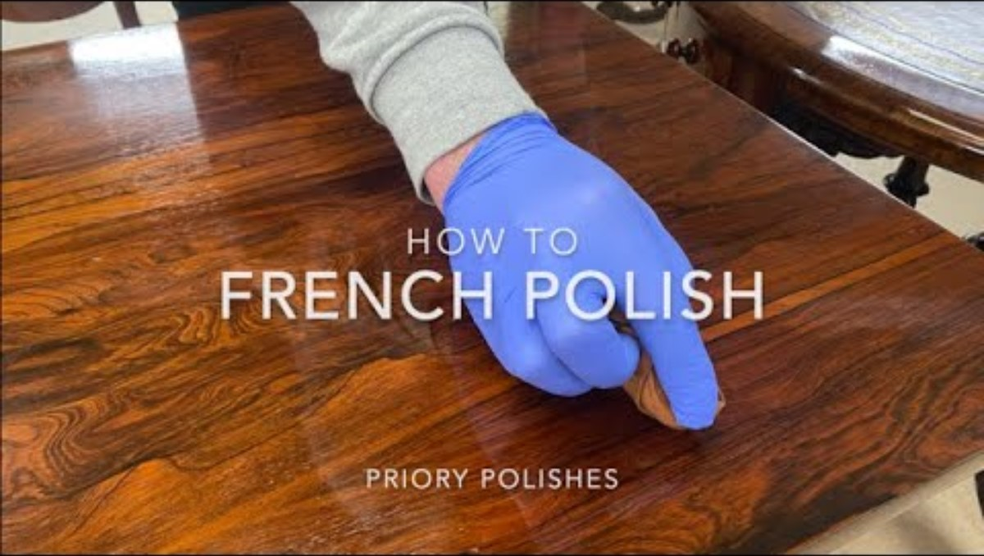
French Polish
How to French polish/ Priory Polishes 7.48Mins https://youtu.be/RjA6JuWLEB8?si=m4IEsaUjWZD2owns

Slide 17
French Polish
White Polish made from bleached white shellac.
Button Polish made with button shellac, producing a more orange colour.
Ebony Polish, gives a jet-black finish when applied.
Garnet Polish gives an attractive deep rich brown cast to wood.
Applied in numerous coats using a fad and sanding in between coats.
Used for repairing antiques.

Slide 18
Wax Polish
A good quality wax polish with added beeswax will gently lift and remove grime.
Wax gives a hard protective coating with a natural sheen.
Traditional wax has no added oils, colour or perfume.
Wax Polishes are available in a number of forms including liquid, paste, a special brushing wax, coloured waxes and staining waxes.
Beeswax is a natural wax produced by honeybees of the genus Apis. The wax is formed into scales by eight wax-producing glands in the abdominal segments of worker bees, which discard it in or at the hive. In its natural form (without additives) can be used as a non-toxic finish.

Slide 19
Lacquer Health & Safety
Some lacquers are toxic and inflammable so safety precautions should be taken.
Wear proper respiratory mask to protect your eyes, nose and mouth.
Spray in a well ventilated room.
Always check pressure valves and clocks when you first turn on the compressor.
Water based lacquers are now widely available and the offer the same properties but with fewer toxins.
Volatile Organic Compounds (VOC’s) are solvents that the lacquer is suspended in and these are released as the lacquer is sprayed. VOC’s are extremely harmfully to the person spraying as well as the atmosphere. We are governed by the European Union Directive 2012

Slide 20
Lacquer
Four basic types: What are they?
Nitrocellulose
Polyurethane
AC lacquer – Acid Catalysed, sold separate, mix before spraying
Polyester
Nitrocellulose normally sold PC, Pre-Cat or pre catalysed already mixed.
Lacquers and paints give a harder and more resistant finish than French polish, Wax or oils.
They are generally applied by brush or spray gun.
Available in gloss, satin and matt finishes.

Slide 21
Lacquer
Nitrocellulose Lacquer
Cheap
Quick drying
Produces a hard heat and moisture proof
Used on kitchen doors, cabinets, chairs and other furniture.
Polyurethane Lacquer
Expensive.
Excellent hard surface.
Good heat, moisture and wear resistant properties.
As a water-based product often used as a floor sealer, leaves no brush marks, excellent resistance to wear and tear and most household chemicals.

Slide 22
Lacquer
Acid-catalysed (AC lacquers)
Expensive.
Produces a very durable heat and moisture proof surface.
Layers set by polymerization.
Repairs to this surface are not easy to do.
Tough finish used on furniture, kitchen doors etc.

Slide 23
Lacquer
Polyester Lacquer
Expensive.
Hardest and most durable of all the lacquers
It dries fast so can only be applied with spray gun.
One coat is sufficient.
High gloss finish cannot be repaired if scratched. Item will have to be stripped and refinished

Slide 24
Lacquer
Acrylic Lacquer
Water based and contains synethic acrylic polymers which dry to a “water white” this reduces the yellowing problems associated with nitrocellulose lacquers.
No smell and non-flammable.
Reasonably priced.
Produces a extremely hard-wearing and moisture proof surface.
Tough finish used on furniture, floors etc.
Floor lacquer tend to have other additives

Slide 25
Faults with Spraying (Ph 6)
What is Orange peel?
Orange peel is simply the failure of a finish to level properly, and has a number of causes:
The number one cause of orange peel is that the material is too thick. The wrong thinner, especially cheap ones, have the wrong blend of solvents (usually to fast, or hot) and won't let the finish level properly.
The thicker the liquid, the more air required; the thinner, the less air needed. The obvious fix is to increase the air pressure or thin the material.
Dirty air cap or fluid tip.

Slide 26
Faults with Spraying (Ph 6)
What is blooming?
A milky white haze, cloud or mist can form on the surface of the lacquer. Condensation droplets land on the surface and when drying out leaves white hazy spots.

Slide 27
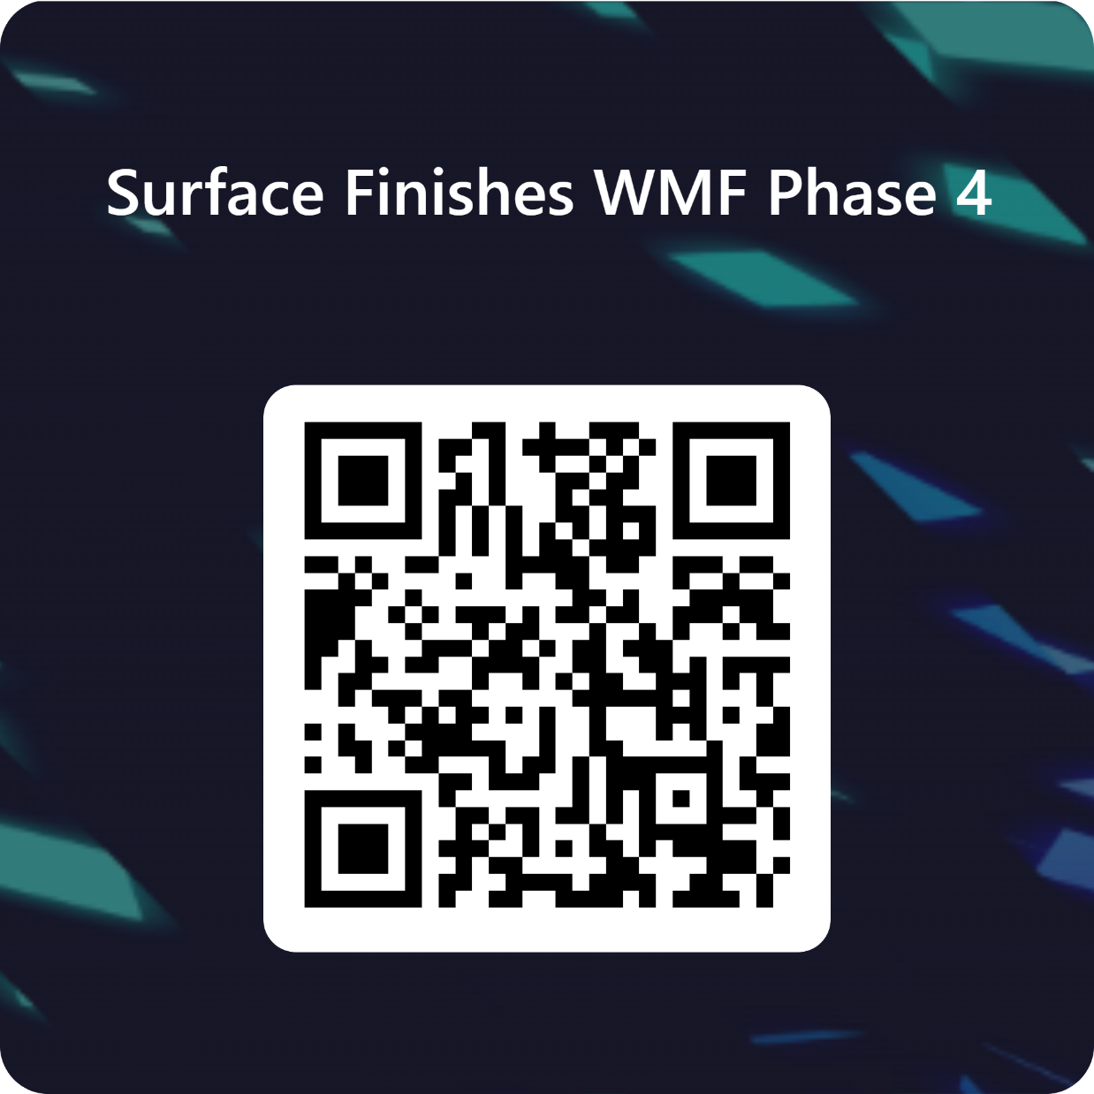
Revision
To test your knowledge, click the link below or scan the QR code below.
https://forms.office.com/e/9s9Ug05M4G
Important
Short answer questions require a few sentences unless you are asked to list or name something.

